Slide 1
KRISM – KRYLOV subspace based optical computing of hyperspectral images
Vishwanath Saragadam
Aswin C. Sankaranarayanan

Slide 2
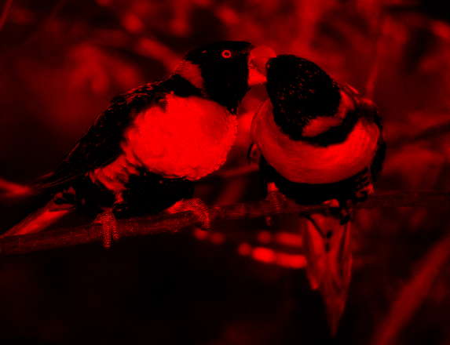

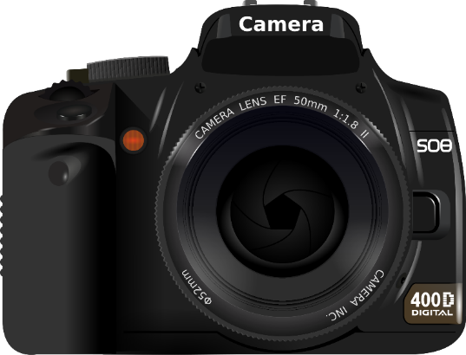
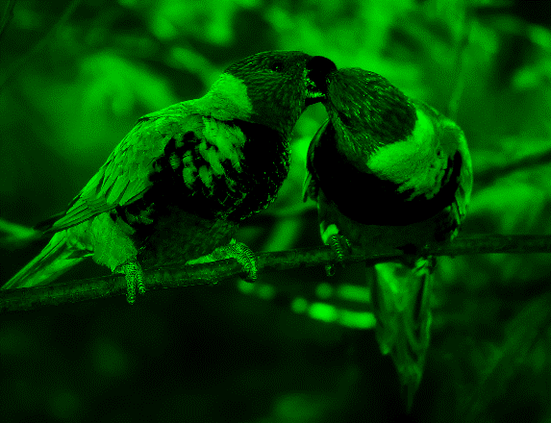
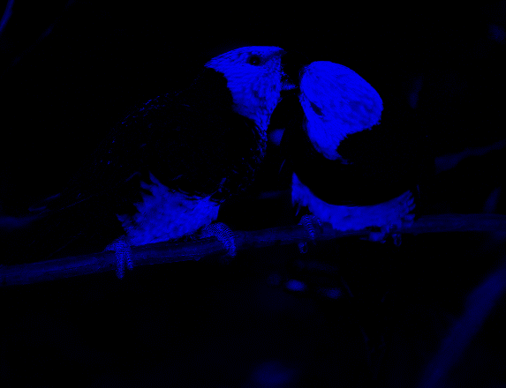
Color camera
Notes:
Light interacts richly with the objects around us, resulting in vibrant looking images.
One such important interactions is how light’s intensity changes as a function off wavelength – called spectrum.
Every object modifies the illuminant light in a specific manner, which is then captured by a camera resulting in the well known red, green and blue color images
However, the higher dimensional counterpart of color, the spectrum, is a unique property of materials and is of great interest in several vision and scientific tasks

Slide 3


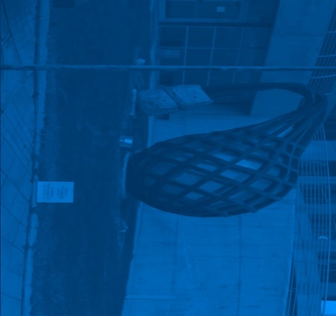
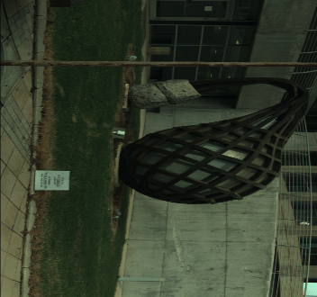
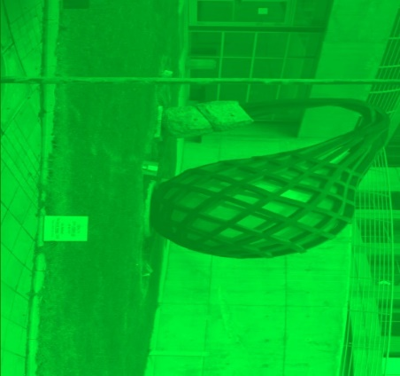
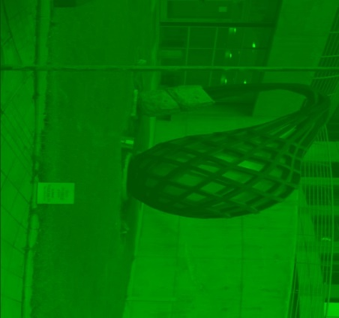
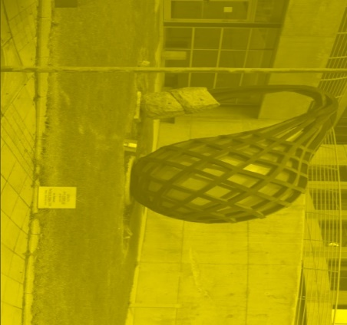
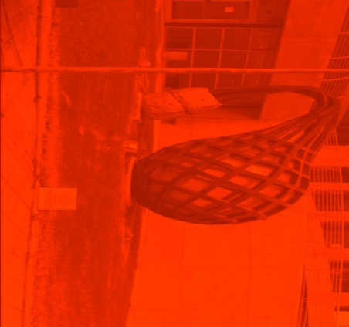
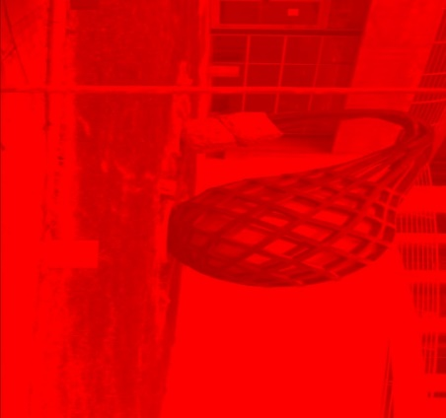

420nm
450nm
480nm
Hyperspectral camera
510nm
540nm
570nm
600nm
630nm
660nm
Hyperspectral image from ICVL lab
Notes:
Capturing spectral profile at each spatial location can be achieved via a hyperspectral camera, which results in a stack of images at narrowband wavelength ranges.
The resultant set of images is called a hyperspectral image

Slide 4
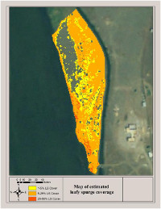
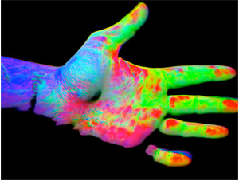
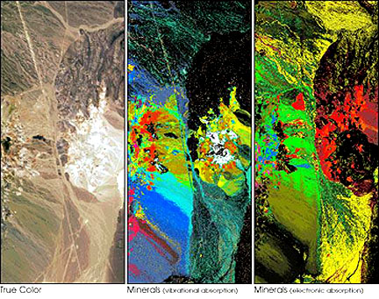
Applications of Hyperspectral Image
Environment monitoring
Medical diagnosis
Geosciences
https://www.resonon.com/applications_main.html
Notes:
1. And finds use in several real world scenarios such as environmental monitoring, medical diagnostics, and geosciences

Slide 5
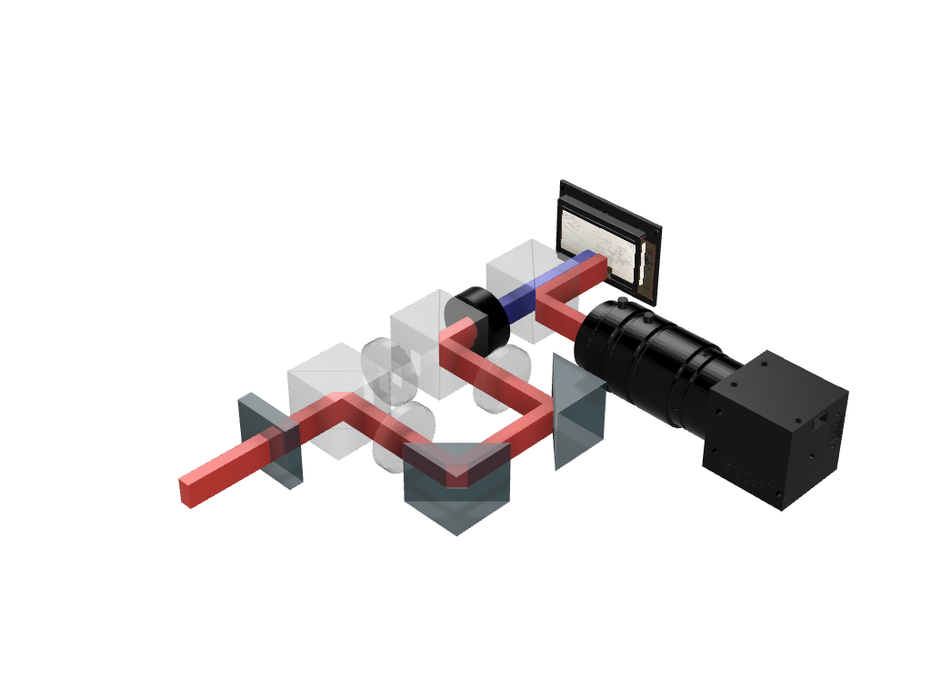
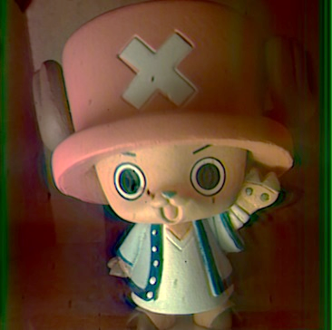


KRISM: A New Evolution in Hyperspectral Imaging
Peaks of CFL
1
1
Novel, Adaptive Imager
High spatial ($<10μm$), spectral ($3nm$) resolution
High compression in measurements ($>20×$)
Optical low-rank approximation of HSI
Notes:
We introduce KRISM, a new evolution in hyperspectral imaging for fast, efficient, and high resolution imaging
KRISM is a novel adaptive imager that is capable of high spatial, and spectral resolution, while requiring twenty times fewer measurements than traditional imagers
Our contributions rely on the idea of optically computing a low-rank approximation of the hyperspectral image, which leads to highly efficient sampling
To understand our contributions, we first look at traditional hyperspectral cameras and their drawbacks.

Slide 6
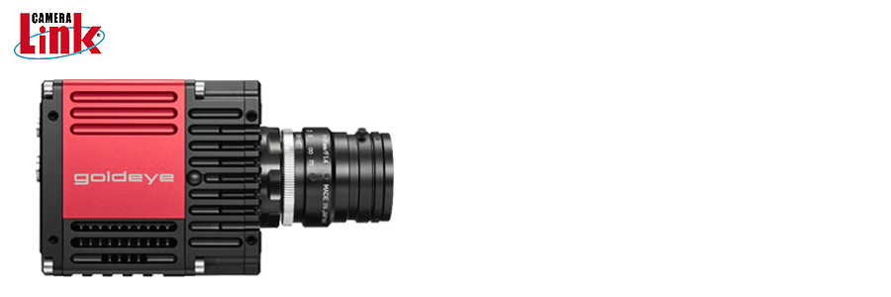
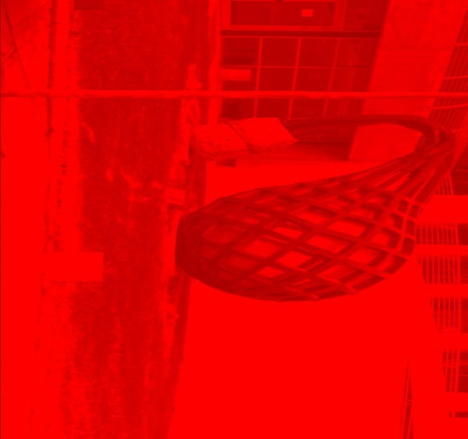
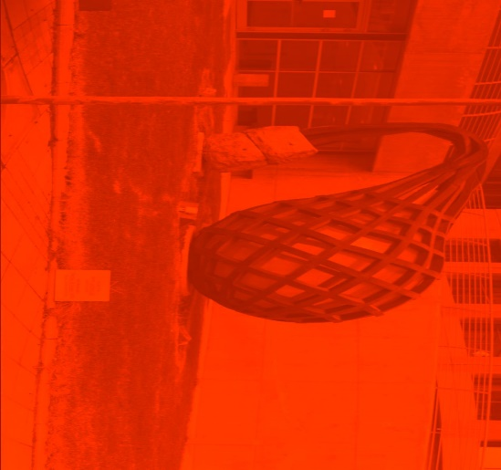




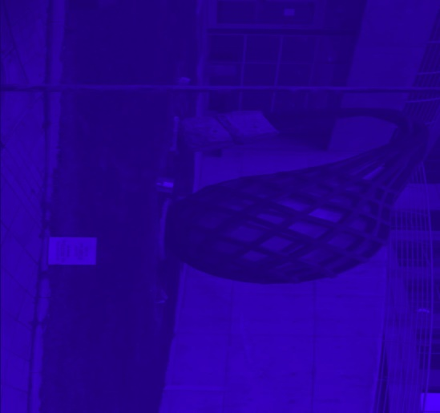




Challenges with Hyperspectral Cameras
Too many measurements
Tunable spectral filter
Most light blocked
$$λ$$
$$400nm$$
$$700nm$$
Camera spectral filter
Notes:
Off-the shelf hyperspectral cameras work by scanning each spatio-spectral voxel at a time
A good example is the tunable-filter based camera
Here, a grayscale camera is equipped with a programmable, narrowband spectral filter
By sweeping the narrowband wavelengths across the spectral range, we can capture the full hyperspectral image
Such a setup faces two major drawbacks – namely that the number of measurements are quite large – for a megapixel image with 100 spectral bands, this is a hundred million voxels
Second, due to narrowband spectral filters, most light is blocked in every measurement, leading to severe loss in signal to noise ratio.

Slide 7
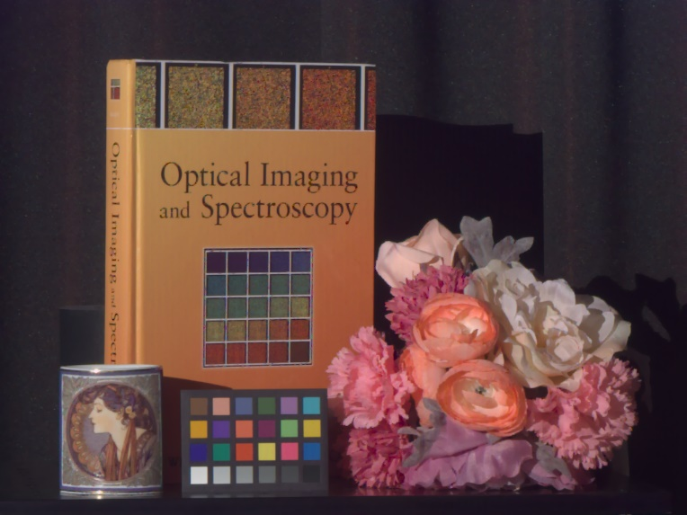
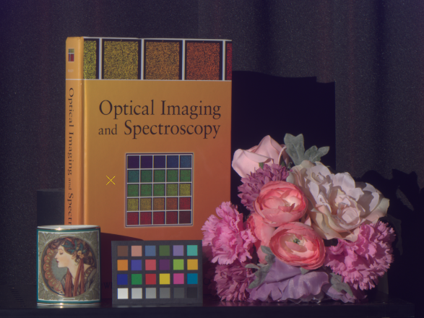
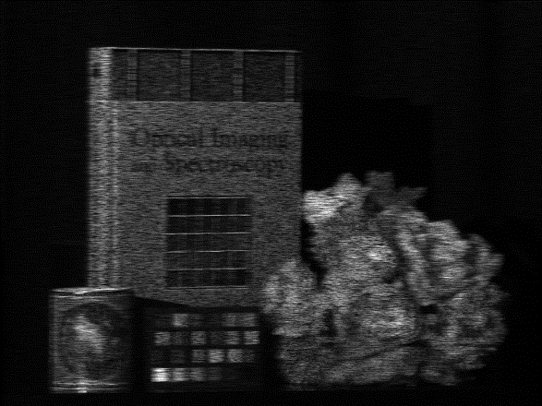
Compressive Snapshot Approaches
Scene
Spatial and/or spectral mixing
Recovered HSI
Prior: sparse spatial gradients, low rank
Solver: $ℓ_{1}$ minimization, neural networks (data driven)
Too many unknowns – noise amplification, and/or overly smooth spectra
Can we sample only the relevant parts of the signal?
Choi et al., “High-Quality Spectral Reconstruction Using a Spectral Prior”, ACM SIGGRAPH Asia 2017
Notes:
A common approach to overcoming the measurement burden is to rely on capturing a small set of multiplexed measurements
Typically, this involves a single snapshot measurement with spatial and spectral multiplexing, and then relying on signal priors, such as sparse gradients to reconstruct the hyperspectral image
Solving the linear inverse problem involves optimization problems such as l1 minimizers, or more recently, data-driven approaches such as neural networks.
Despite the appeal of a snapshot approach, the high compression in measurements means that there are far more unknowns, leading to noise amplification, and overly smooth spectral profiles
We then ask the question, can we build imagers to sample only the relevant parts of the signal?

Slide 8
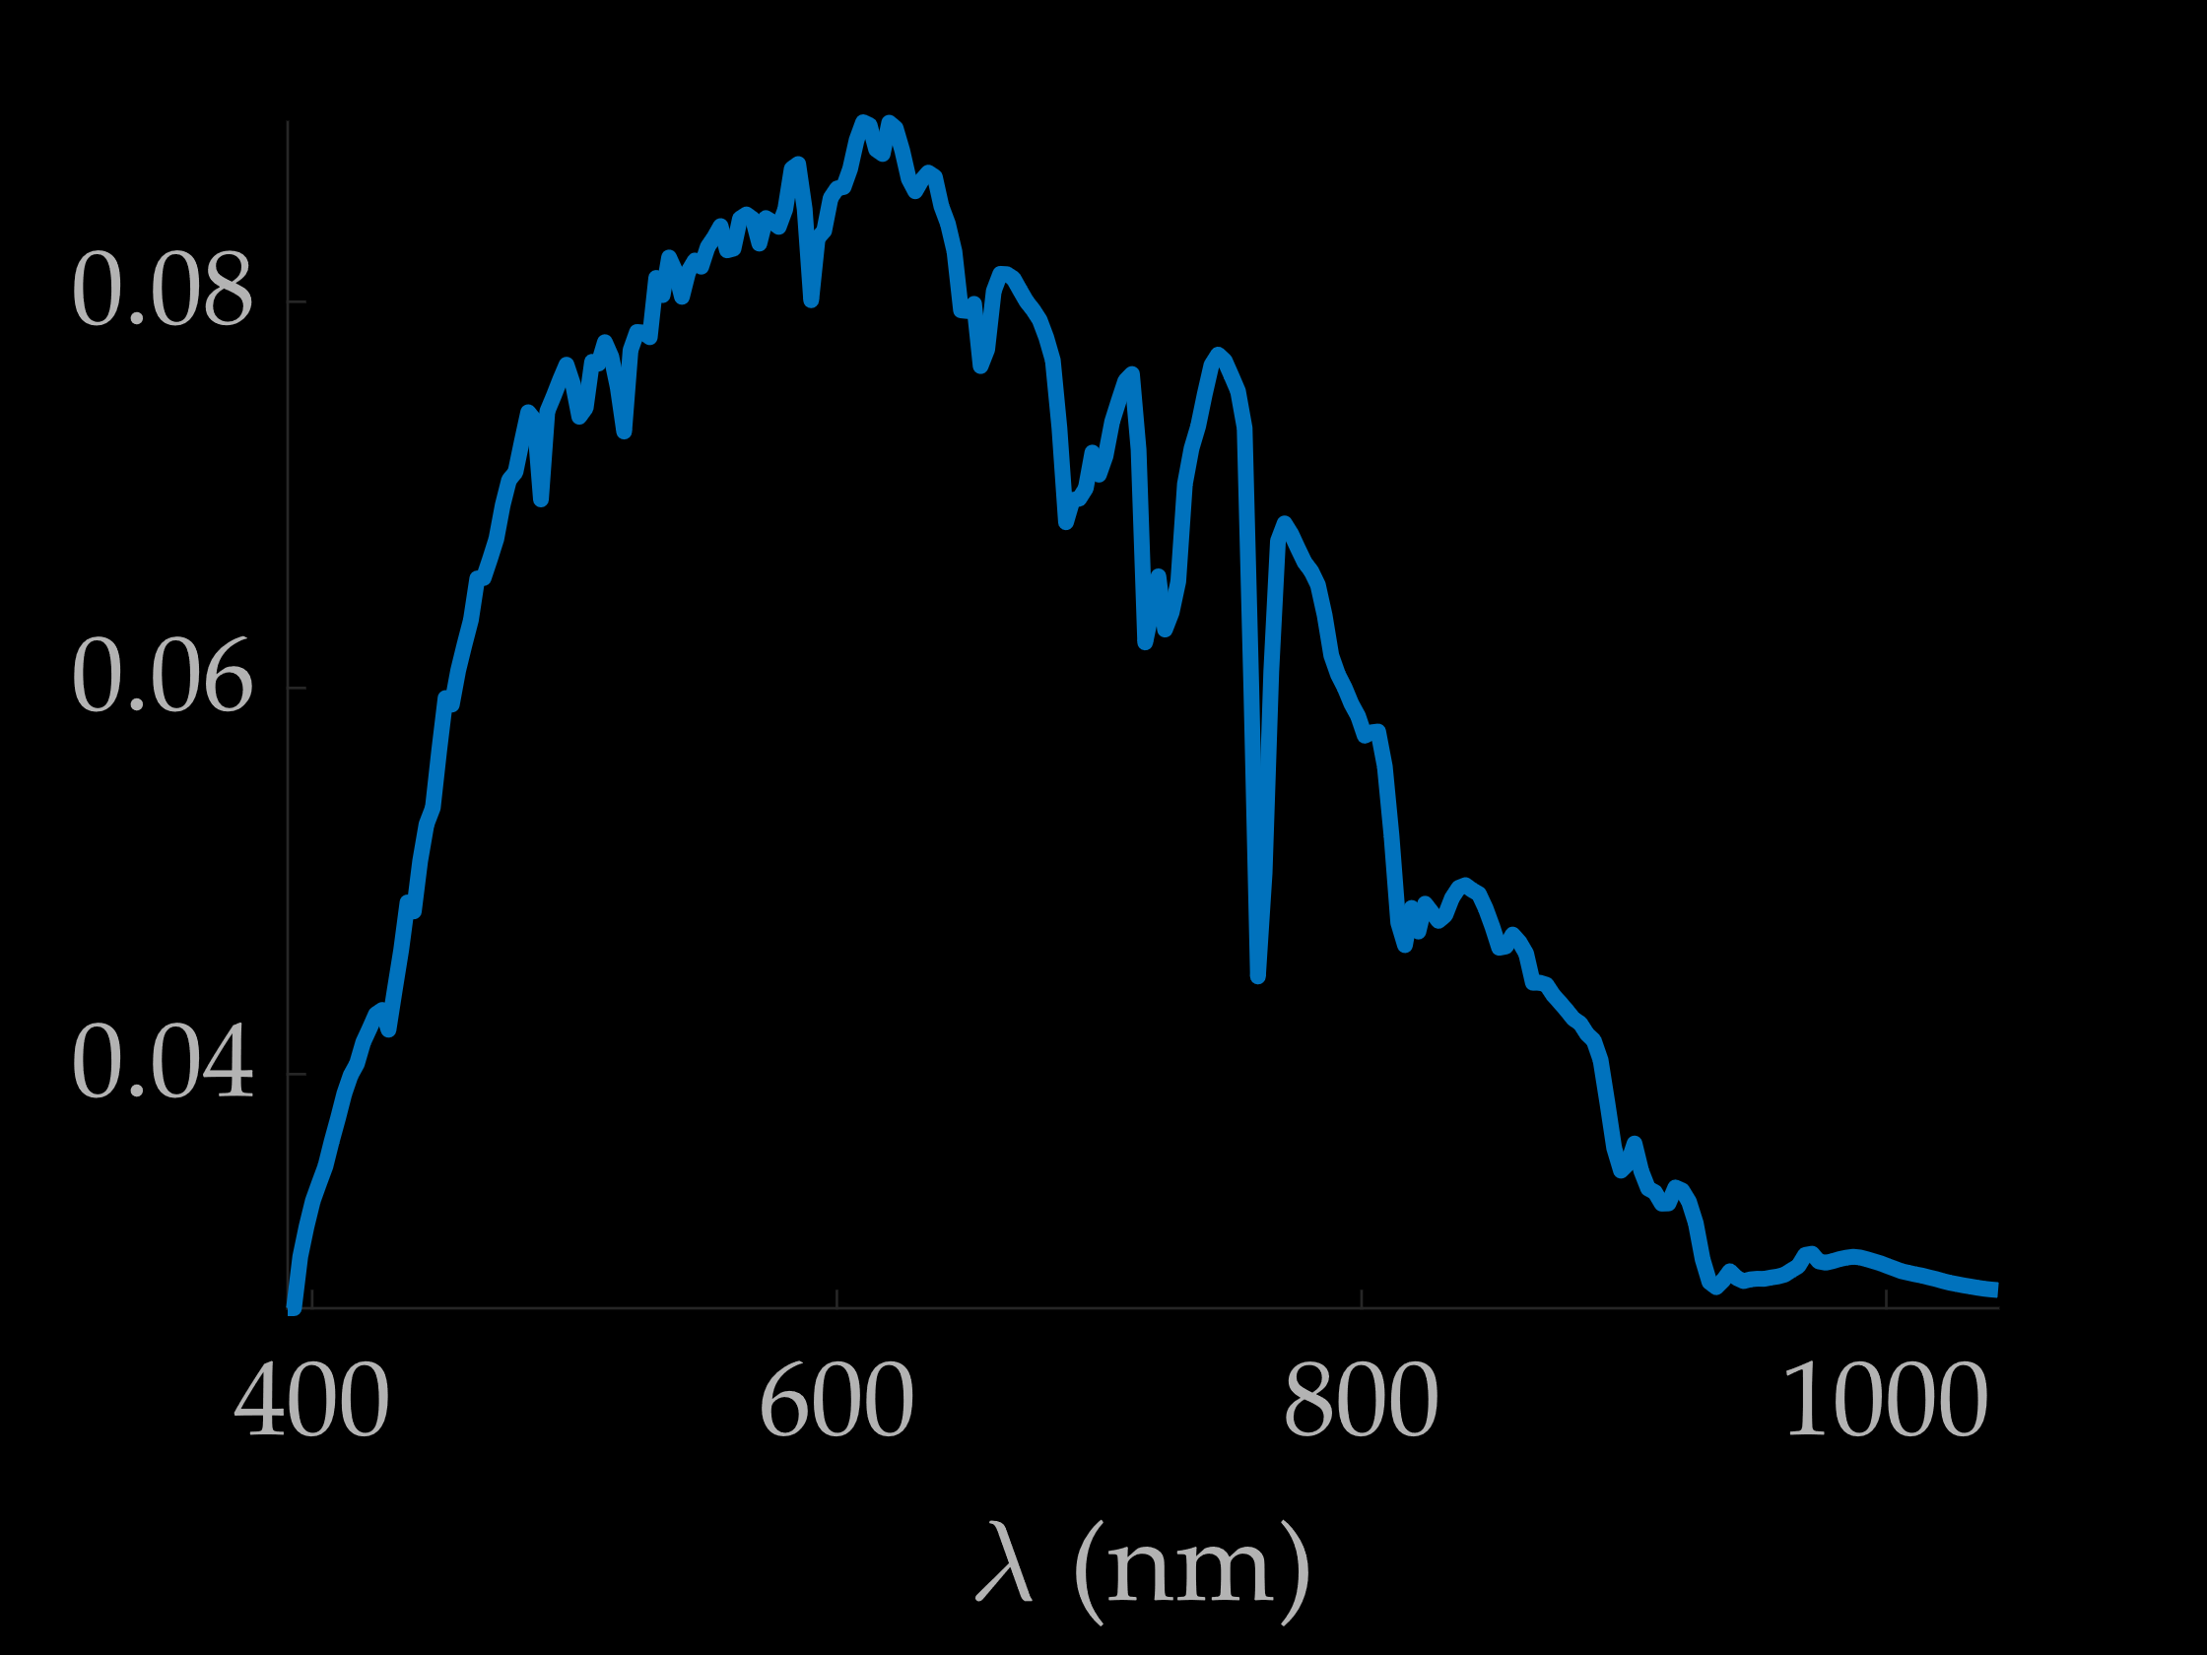
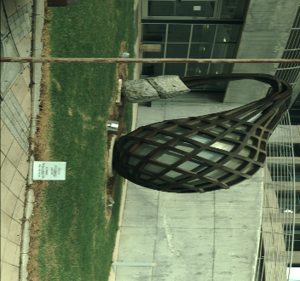
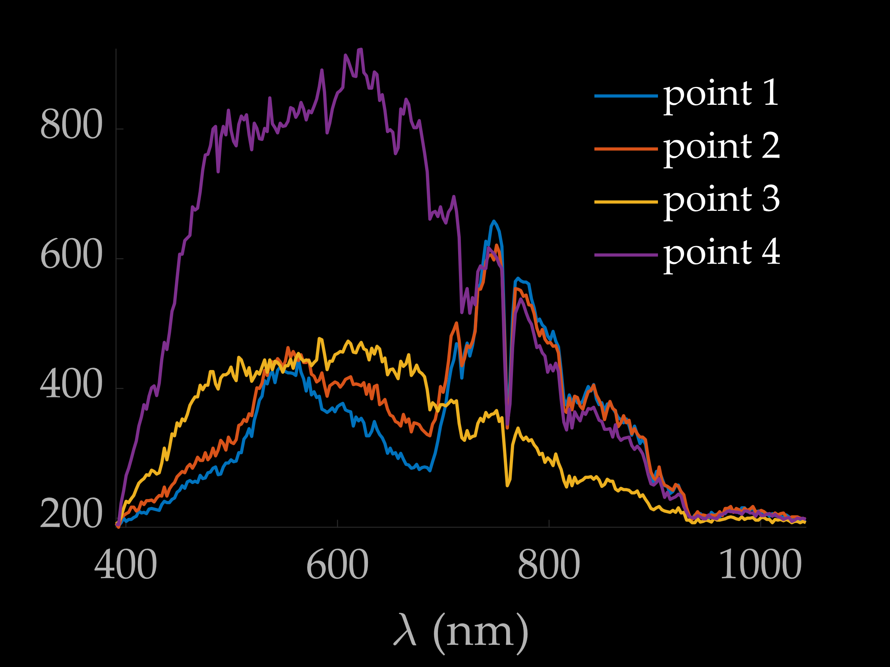
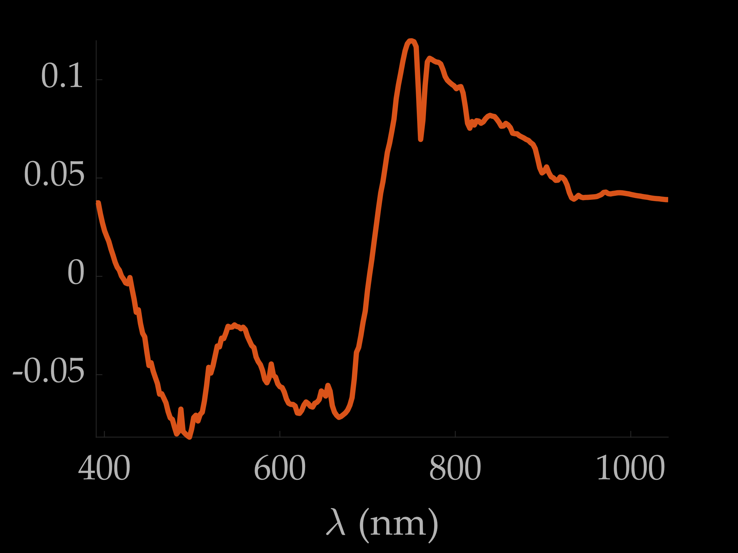
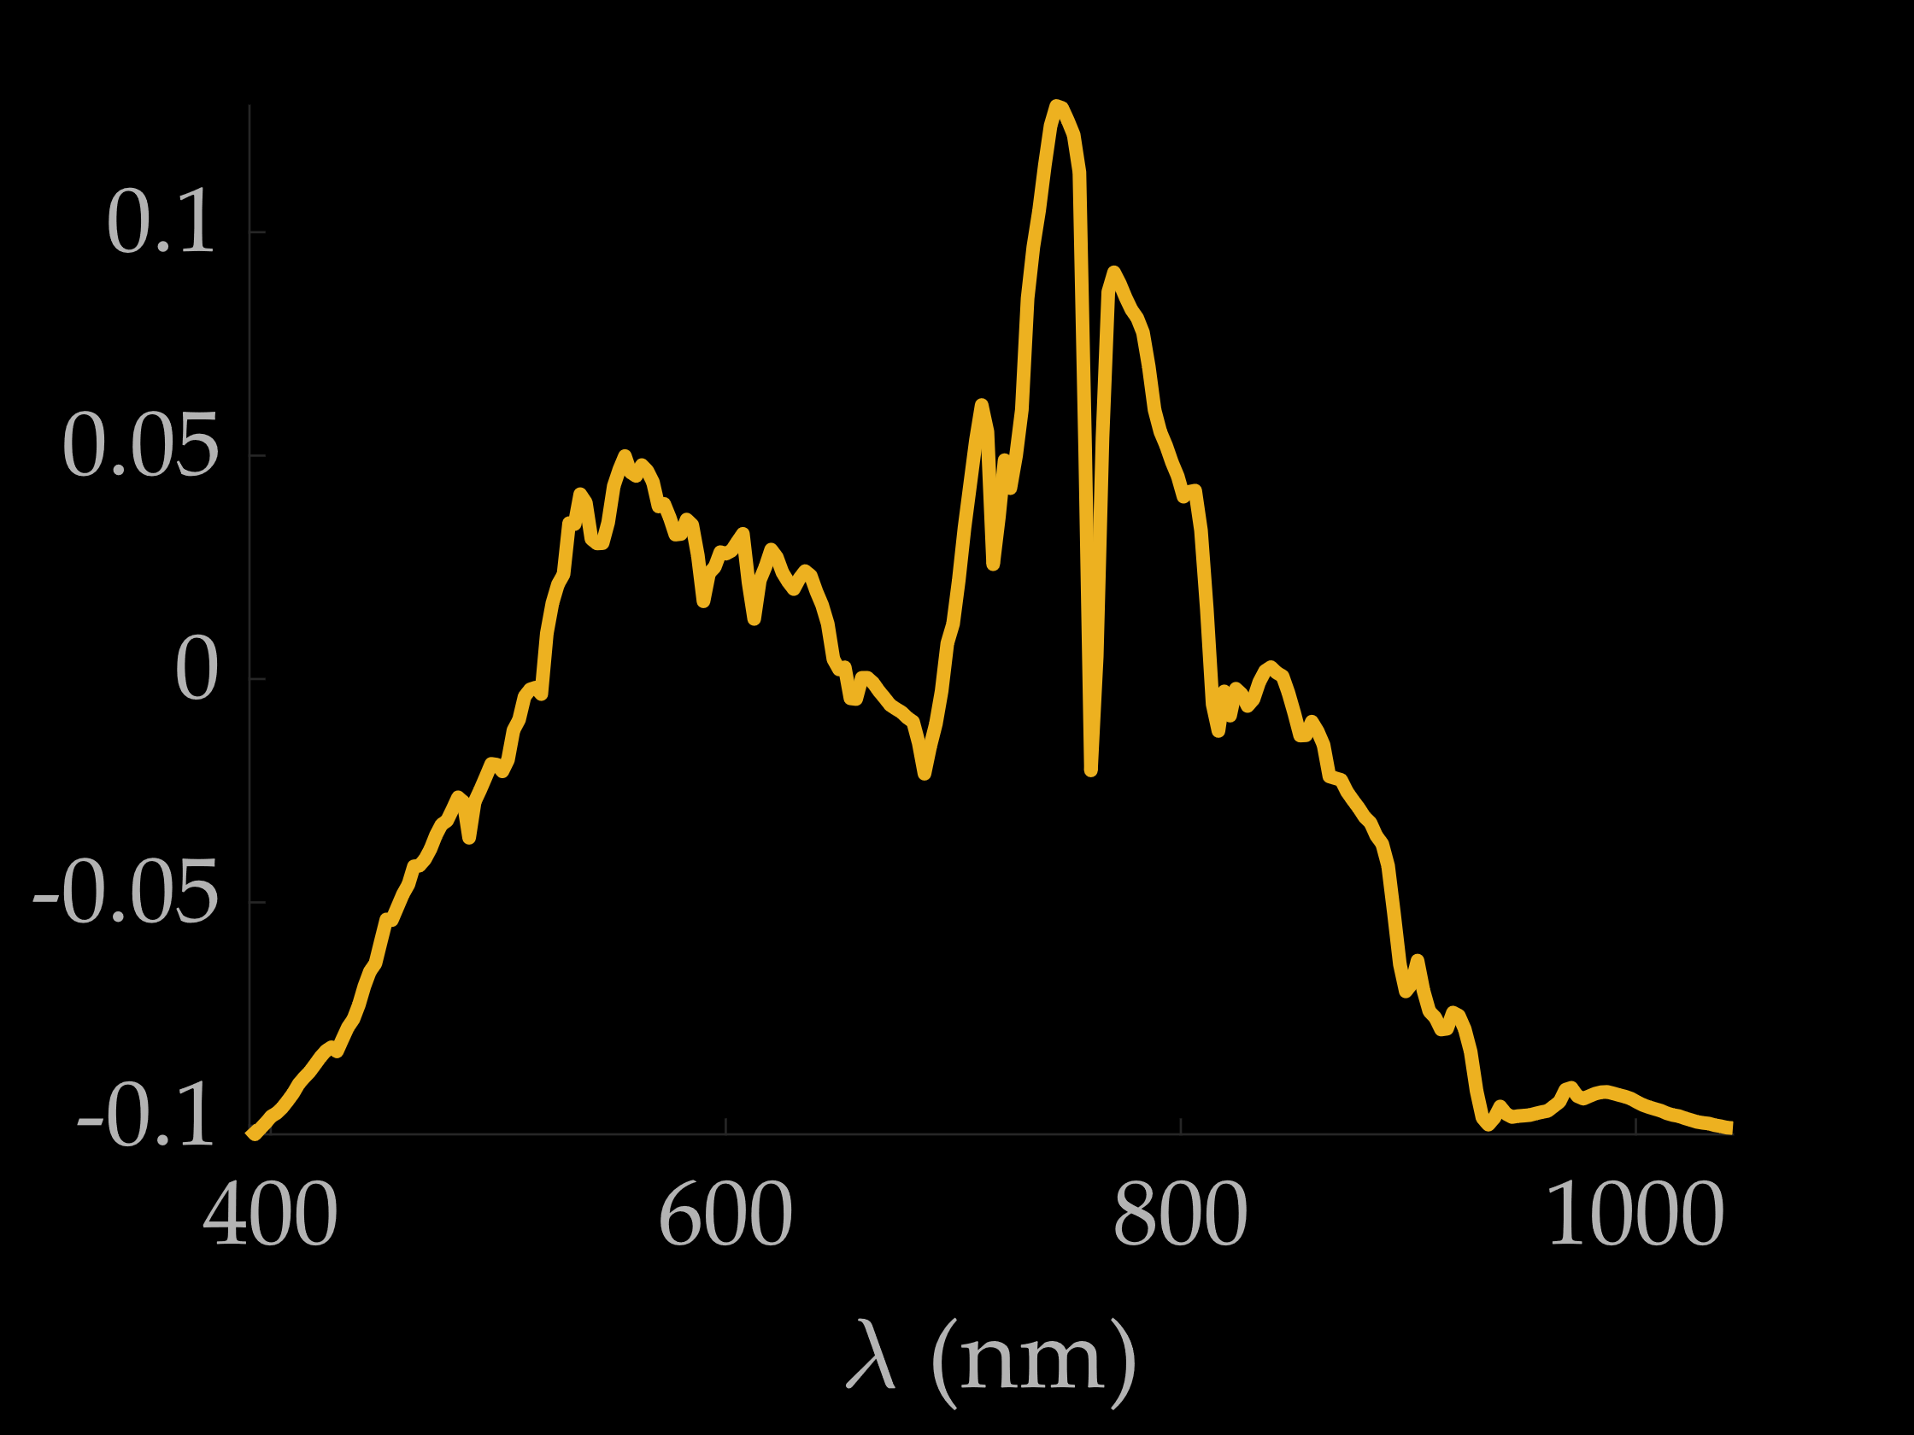


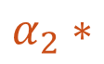



Spectral Similarity of Natural Scenes
$$α_{1}∗$$
4
$$+$$
3
$$=$$
$$α_{2}∗$$
1
2
$$+$$
$$α_{3}∗$$
Small set of unknown basis spectra
Notes:
To do so, we first briefly look at the structure of hyperspectral images.
Despite the high dimensionality of hyperspectral images, they are often low-dimensional signals
To appreciate this, let us look at the spectral profiles at some locations in a natural scene – we see that the spectra are highly correlated – the reason being that spectral profiles of a material are similar in all points in space
We can then represent all spectral profiles in the scene as a combination of a small set of basis spectral profiles.
However, these basis spectra are unknown, and are specific to each scene
Let us then formalize the signal model of hyperspectral images, and understand how we can exploit it.

Slide 9
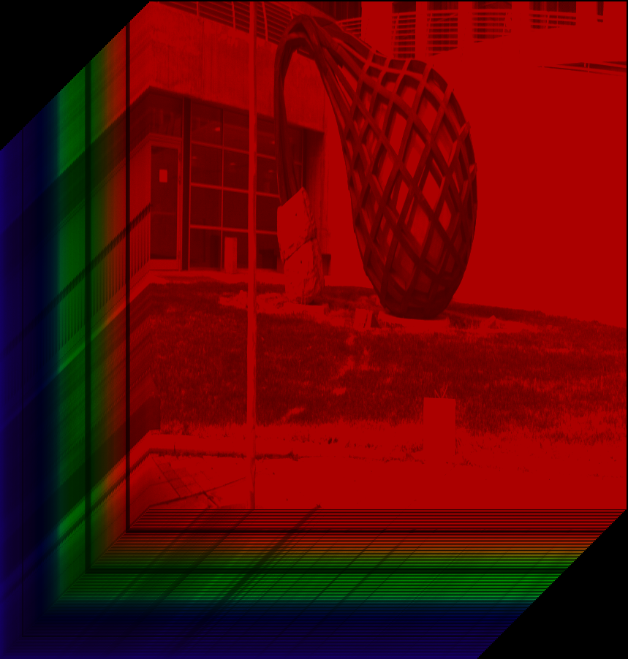
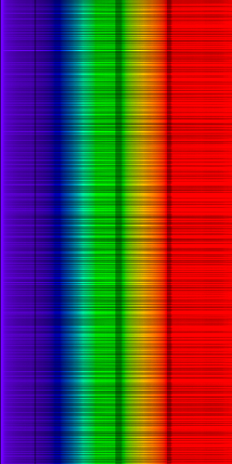
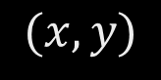




Low-rank Representation of HSI
$$λ$$
Reshape
Low-rank matrix
$$(x, y)$$
$$H(x, y, λ)$$
$$N_{x}×N_{y}×N_{λ}$$
$$X∈ℝ^{N_{x}N_{y}×N_{λ}}$$
Notes:
Mathematically, we can state that hyperspectral images are low-rank
Specifically, if we reshape the 3 dimensional hyperspectral image in to a 2D matrix, where each column is an image, and each row is a spectral profile, we observe that this 2D matrix is low rank

Slide 10
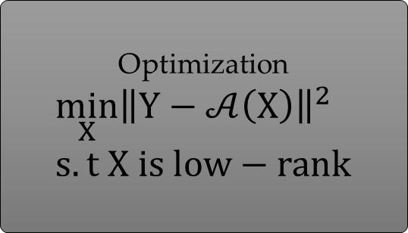


Low-rank as Regularizer
Optimization
$$\min_{X}{{\left\|Y−𝒜\left(X\right)\right\|}^{2}} \\ s.t X is low−rank$$
Random Linear Projections
$$Y=𝒜(X)$$
Uses low-rank as a prior, not during sensing itself
Slow recovery, prone to noise amplification
$$X$$
Can we directly sense the low-rank subspace?
Fazel et al., “Compressive Sensing and Robust Recovery of Low Rank Matrices”, IEEE Asilomar Conf. Signals, Systems, and Computers, 2008
Notes:
A simple approach to exploit the low-rank model would be to rely on compressive sensing strategy – we can capture random linear projections, and then utilize the low-rankedness as a regularizer
However, such a solution is often slow, and prone to noise amplification
Can we instead directly tease out the low-rank subspace without measuring the whole hyperspectral image?
To do so, we look at a powerful tool in linear algebra, called the power iterative technique

Slide 11


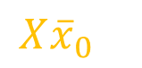
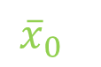
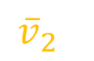
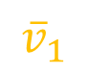
Power Iterative Technique
$${\overline{x}}_{0}$$
$$X$$
$${\overline{v}}_{1}$$
$${\overline{v}}_{2}$$
$$X{\overline{x}}_{0}$$
Always lies in column space of $X$
Notes:
To motivate the power iterative technique, consider a toy example, where the matrix X is a symmetric matrix, with a low-dimensional subspace shown as a plane
Let v1 and v2 be its singular vectors
Now consider a simple operation, where an arbitrary vector x0 is multiplied by the matrix X
We observe that the projection, Xx0 always lies in the subspace of x

Slide 12
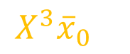

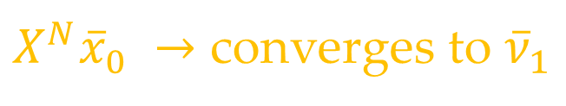
Power Iterative Technique
$${\overline{x}}_{0}$$
$$X$$
$${\overline{v}}_{1}$$
$$X^{3}{\overline{x}}_{0}$$
$${\overline{v}}_{2}$$
$$X^{2}{\overline{x}}_{0}$$
$$X{\overline{x}}_{0}$$
$X^{N}{\overline{x}}_{0} →$ converges to ${\overline{ν}}_{1}$
Notes:
We make another fascinating observation
As we take the input of the first projection and multiply with the matrix again, the resultant vector moves closer to the first eigenvector
As the number of iterations are increased, the X raised to N times any arbitrary vector converges to first singular vector

Slide 13
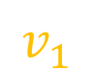

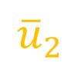
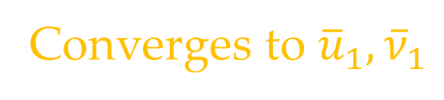
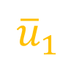
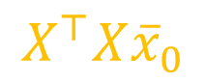
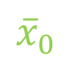
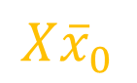

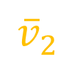
Asymmetric Matrices
$$X$$
$${\overline{x}}_{0}$$
$${\overline{u}}_{1}$$
$$X^{⊤}$$
$$X{\overline{x}}_{0}$$
$${\overline{u}}_{2}$$
$${\overline{v}}_{2}$$
$$v_{1}$$
$$X^{⊤}X{\overline{x}}_{0}$$
Converges to ${\overline{u}}_{1}, {\overline{ν}}_{1}$
Notes:
In case of asymmetric matrices, we iterate between the subspaces spanned by X, and X transpose
As with the symmetric case any arbitrary vector x0, when multiplied with X transpose, collapses to the subspace of X, and vice versa
Similar to the symmetric case, the matrix vector products converge to the first, left and right singular vectors u1 and v1

Slide 14




Multiple Singular Vectors
$${\overline{x}}_{0}$$
$$X$$
$${\overline{v}}_{1}$$
$$X^{3}{\overline{x}}_{0}$$
$${\overline{v}}_{2}$$
$$X^{2}{\overline{x}}_{0}$$
$$X{\overline{x}}_{0}$$
$\left[{\overline{x}}_{0}, X{\overline{x}}_{0}, X^{2}{\overline{x}}_{1},…, X^{N}{\overline{x}}_{0}\right] →$ Spans the subspace
Only requires matrix vector multiplications
Notes:
We can extend this procedure to obtain more than one singular vector by utilizing the intermittent matrix-vector multiplications
A key observation we make about this process is that estimating a small set of singular vectors does not require us to know the entries of X, but only requires access to matrix-vector multiplications
When applied to hyperspectral imaging, this would mean that we do not need to fully measure the whole hyperspectral image, but only need access to some linear operations on it.

Slide 15
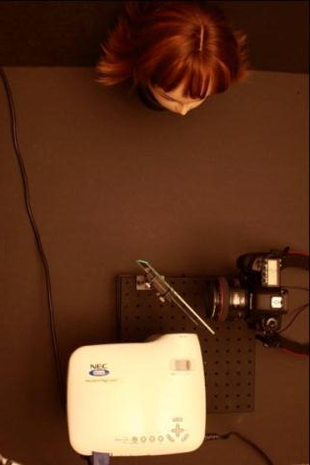

Prior Work: Optical Computing for Light Transport Matrix
$$i=Tp$$
beam splitter
camera image
Light Transport Matrix
projector pattern
camera
projector
O’Toole, and Kutulakos, “Optical Computing for Fast Light Transport Analysis”, ACM SIGGRAPH Asia, 2010
Notes:
The idea of relying on matrix-vector products for explored in optical computing for light transport matrix, where the very high dimensional light transport matrix is probed by repeatedly projecting a pattern, capturing an image, and then reprojecting the captured image
We apply this approach to HSIs
In the next few slides, we will look at translating algebraic operations to optical ones.

Slide 16
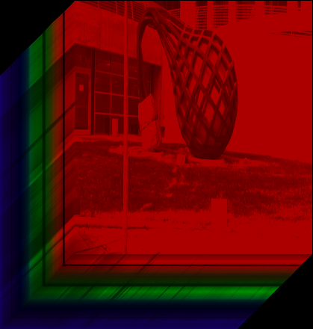
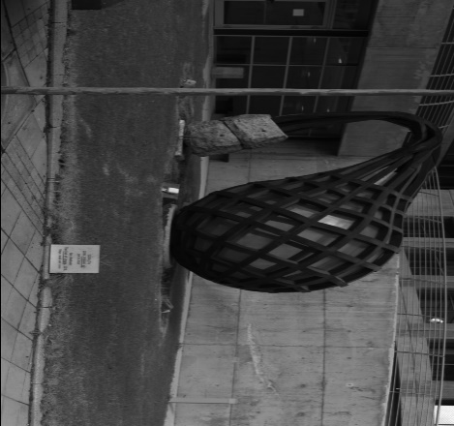







Optical Right Matrix-Vector Multiply
Algebraic Domain
Optical Domain
$$y^{right}=Xν$$
$$y^{right}$$
$$X$$
$$ν$$
$$=$$
Image $I\left(x, y\right)$
Camera with response $ν\left(λ\right)$
Spectrally-programmable imager
Notes:
Let us look at the first step, namely, right matrix multiplication
Algebraically, we are looking at multiplying each row of the matrix X with the weights determined by nu, and summing up – resulting in an image
Optically, this is implemented by capturing a grayscale image with a camera who’s spectral response is given by nu
Such an optical setup is called a spectrally-programmable imager

Slide 17








Optical Left Matrix-Vector Multiply
Algebraic Domain
Optical Domain
$$y^{left}=X^{⊤}ν$$
$$y^{right}$$
$$X^{⊤}$$
$$ν$$
$$=$$
Image $ν\left(x, y\right)$
Spectrum
$y^{left}(λ)$
Spatially-coded spectrometer
Notes:
Now let us consider the left matrix multiplication
Algebraically, each column of the matrix X is multiplied by the weights given by nu and summed up – resulting in a spectral measurement
Optically, this is implemented by coding the intensity of the scene with weights of nu and then measuring the average spectrum
Such an optical setup is called a spatially-coded spectrometer

Slide 18














Optical Power Technique for HSI
$$y_{1}^{right}=Xy_{0}^{left }$$
$$y_{2}^{left}=X^{⊤}y_{1}^{right }$$
Only need two optical implementations!
$$u_{1}\left(x, y\right)$$
$$y_{2}^{right}=Xy_{2}^{left }$$
KRISM: Krylov subspace-based Imaging and SpectroMetry
$$⋮$$
$$⋮$$
$$y_{N}^{left}=X^{⊤}y_{N}^{right }$$
$$v_{1}\left(λ\right)$$
$$u_{1},v_{1}$$
Notes:
Now, as an example, to compute the first singular vector, we start with an arbitrary spectral filter to capture a grayscale image
We then use the grayscale image to code the scene, and capture a single spectrum
Then this spectrum is used to capture a grayscale image, and the process is repeated
This results in the most dominant singular vector u1, v1
To achieve this, we did not need the full hyperspectral image, but only two simiple optical operators
We call this setup KRISM – standing for Krylov subspace-based Imaging and Spectrometry

Slide 19






Simulations: Low Spectral Resolution (30 bands)
Lin et al. (29.8dB)
1 image
Choi et al. (29.8dB)
1 image
KRISM rank-1
(21.8dB)
1 image, 1 spec.
KRISM rank-4
(38.6dB)
4 images, 4 spec.
RGB image of scene
Hyperspectral image from KAIST lab
Notes:
Let us look at results from various hyperspectral imaging approaches with low spectral resolution with 30 bands
The work by Lin and others captured a single snapshot image of the scene, and recovered the hyperspectral imaging using overcomplete dictionaries
Choi and others improved upon this by recovering using artificial neural networks
A fair comparison would then be a rank-1 approximation using KRISM – whereas a more accurate result would require a rank-4 approximation
Indeed, snapshot approaches are competitive options when spectral resolution is low – however, they do not scale well for higher spectral resolutions

Slide 20










Simulations: High Spectral Resolution (250 bands)
Sun and Kelly
(41.1dB)
$5×$ compression
Kittle et al. (43.2dB)
$$5×$$
Fazel et al.(40.7dB)
$$43×$$
KRISM (47.7dB)
$$43×$$
RGB image of scene
Hyperspectral image from ICVL lab
Notes:
For higher spectral resolution, such as 200 or more spectral bands, there are several multi-frame approaches
Sun and Kelly’s approach relies on a single-pixel camera architecture, with photodetector replaced by a spectrometer
Kittle and other’s approach is a variant of CASSI, where multiple images are captured with different spatial masks
A non-adaptive variant of KRISM is the low-rank compressive sensing work by Fazel, which relies on random row and column projections – which results in better reconstruction than other existing approaches,
However, KRISM outperforms all other approaches in terms of accuracy, as well as fewest measurements.

Slide 21
Relative Merits
Method | Merits | Demerits
Snapshot approaches (CASSI, SSCSI) | Single image, simple setup | Noise amplification, prolonged reconstruction, not suited for high spectral resolution
Multi-frame approaches | Well suited for high spectral resolution | Low compression ratio, prolonged reconstruction
KRISM (proposed) | High spectral resolution, very few measurements, very low reconstruction time | Not suited for low spectral resolution, complex optics
Notes:
Let us look at the overall merits of various approaches
Snapshot approaches are well suited for low spectral resolution, and requires capture of a single image, with a simple optical setup
However, due to high compression ratios, there may be noise amplification, and is not suited for high spectral resolutions.

Slide 22
Relative Merits
Method | Merits | Demerits
Snapshot approaches (CASSI, SSCSI) | Single image, simple setup | Noise amplification, prolonged reconstruction, not suited for high spectral resolution
Multi-frame approaches | Well suited for high spectral resolution | Low compression ratio, prolonged reconstruction
KRISM (proposed) | High spectral resolution, very few measurements, very low reconstruction time | Not suited for low spectral resolution, complex optics
Notes:
1. Multi-frame approaches are instead well suited for high spectral resolution – however, the realistic compression ratios are low, and require computationally expensive reconstruction algorithms

Slide 23
Relative Merits
Method | Merits | Demerits
Snapshot approaches (CASSI, SSCSI) | Single image, simple setup | Noise amplification, prolonged reconstruction, not suited for high spectral resolution
Multi-frame approaches | Well suited for high spectral resolution | Low compression ratio, prolonged reconstruction
KRISM (proposed) | High spectral resolution, very few measurements, very low reconstruction time | Not suited for low spectral resolution, complex optics
Notes:
KRISM is well suited for high spectral resolution, requires very few measurements, and is practically reconstruction free
However, KRISM may not be the right solution for low spectral resolution, and also requires complex optics.

Slide 24
Experiments with a Lab Prototype
Notes:
1. We now evaluate the efficacy of our optical setup with real experiments

Slide 25



Optical Setup
diffraction grating
diffraction grating
LCoS SLM
pol. selector
coded aperture
objective
camera
Simultaneously high spatial and spectral resolution
Notes:
We built a compact optical setup that relies on polarization to switch between spatial and spectral coding
Our setup consists of an objective lens that focuses on the scene,
A coded aperture assembly that ensures simultaneously high spectral and spatial resolutions,
A diffraction grating to spread spectrum of the scene,
A spatial light modulator to perform spectral or spatial coding,
And a camera to capture measurements
Along with these, we have a polarization selector that switches between spatial and spectral coding

Slide 26



Optical Setup: Spatial Coding
spatial image
spatial code
diffraction grating
P-polarized
coded aperture
objective
camera
spectral measurement
camera image
Notes:
When the polarization switch is set to allow p-polarization, light follows a straight path, which focuses the image on the SLM, allowing us to code the space,
This forms a rainbow plane on the camera – spectrum can then be obtained by picking a single row of the rainbow image

Slide 27


Optical Setup: Spectral Coding
rainbow image
spectral code
$$λ$$
diffraction grating
S-polarized
coded aperture
objective
camera
camera measurement
Notes:
When light is S-polarized, light follows an alternate path that focuses the rainbow plane on the SLM, allowing us to code the spectrum,
And measure the spatial images
We next see the Krylov iterations of the setup in action.

Slide 28






Optical Krylov Iterations – Iteration 1
code
measurement
$$−1$$
$$1$$
Notes:
We first visualize the Krylov subspace iterations for a scene consisting of four colorful dice
We start by measuring spectrum, by coding the space with an all-ones image, as shown – which results in a single spectral measurement
This spectral measurement is then used as a filter to capture a grayscale image – which completes the first iteration

Slide 29


Optical Krylov Iterations – Iteration 2
code
measurement
$$−1$$
$$1$$
Notes:
The second iteration then consists of using the image from the first iteration to measure a second spectral measurement
Which is then used as a filter to capture the second spatial image

Slide 30


Optical Krylov Iterations – Iteration 3
code
measurement
$$−1$$
$$1$$
Notes:
1. We then repeat the process for some more iterations

Slide 31


Optical Krylov Iterations – Iteration 4
code
measurement
$$−1$$
$$1$$
Notes:
1. Which leads to capturing progressively more information about the scene

Slide 32















Accuracy of Singular Vectors
$$u_{1}$$
Optical SVD; 6 spatial, 6 spectral measurements
$$u_{2}$$
$$u_{3}$$
$$u_{1}$$
$$u_{2}$$
$$u_{3}$$
Tunable filter + SVD – 256 images
Notes:
After as few as six iterations, the optically measured singular vectors are very close to computed singular vectors, which required more than 200 images – underlying the accuracy and efficiency of our proposed approach.
Since the iterations involve capturing images with broadband spectral filters, we do not block all the light – resulting in very high SNR.

Slide 33


Radiometric Accuracy
1
3
1
3
2
4
2
4
1
3
2
4
Notes:
1. Our setup accurately captures reflectance properties of the scenes, as is evident from the closeness of the spectra of various color swatches

Slide 34

High Spatial and Spectral Resolution
Peaks of CFL
1
1
3nm spectral resolution, 10um spatial resolution
$>20×$ measurement compression
Notes:
Finally, KRISM is highly appropriate for measuring very fine spectra and high spatial resolution
To validate this, we illuminated a toy figurine with compact fluorescenetlamp – which has sharp peaks
Our approach can capture hyperspectral images with 3nm spectral resolution, and 1 micron spatial resolution – all at a high measurement compression ratio of 20times or higher

Slide 35
Conclusion
Optical computing – very few measurements
Adaptive sensing – high SNR
High resolution – independent of number of measurements
Notes:
In conclusion, we proposed KRISM – an efficient hyperspectral camera that alternates between spectrally coded imaging and spatially coded spectral measurements.
This optically evaluates the low-rank approximation – requiring very few measurements
Due to the feedback between spatial and spectral measurements, we built an adaptive imager – leading to high SNR
Finally, we showed that we can achieve very high resolution, independent of the number of measurements.
Thank you!

